Slide 1
HOME AUTOMATION USING GOOGLE ASSISTANT
PRESENTED BY
Anju K V (KSD15EC016)
Sanoj C R (KSD15EC061)
Shilpa T (KSD15EC067)
COORDINATOR : AVINASH A
GUIDED BY : DILNA C

Slide 2
CONTENTS
INTRODUCTION
COMPONENTS
Hardware components
Software components
BLOCK DIAGRAM
BLYNK APP SETUP
IFTTT SETUP
CIRCUIT DIAGRAM
WORKING
COST AND EXPENDITURE
CONCLUSION
RESULTS
REFERENCES

Slide 3
INTRODUCTION
Design and prototype of Home Automation System.
Using Google Assistant.
NodeMCU Wi-Fi module as a network provider.
Efficient system for differently disabled people.
Controlling both by speech and mobile.

Slide 4
COMPONENTS
HARDWARE SOFTWARE
1. NodeMCU 1. Google Assistant
2. Relay Board 2. Blynk Application
3. Servo SG90 3. IFTTT
4. DHT 11 4. Arduino IDE

Slide 5
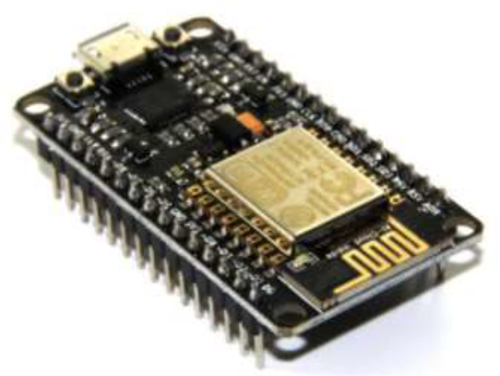
HARDWARE COMPONENTS
1. NODEMCU
Open source IoT platform.
SOC which consists of a microcontroller and a Wi-Fi module.
"NodeMCU" refers to the firmware.
Fig. 1 NodeMCU

Slide 6
HARDWARE COMPONENTS
PIN DIAGRAM SPECIFICATIONS
11 GPIO pins are usable.
6 pins - flash memory chip.
GPIO14 - CLK
GPIO12 - MISO
GPIO13 - MOSI
GPIO15 - Slave Select (SS).
Fig. 2 Pin diagram of NodeMCU

Slide 7
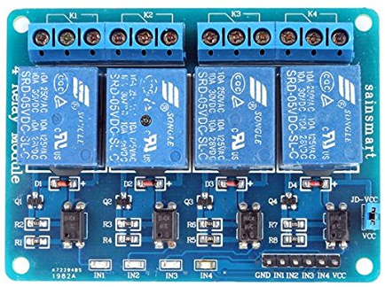
HARDWARE COMPONENTS
2. RELAY MODULE
Operated as switch.
Mainly used are electromechanical relays.
Used to control a circuit by a separate low power signal.
Fig. 3 Four channel relay module

Slide 8
HARDWARE COMPONENTS
3. SERVO SG90
Tiny and lightweight.
Rotate -180 degree(90 in each direction).
Operating voltage: 4.8 V (~5V)
Operating speed: 0.1 s/60 degree
Fig. 4 Servo Sg90

Slide 9
HARDWARE COMPONENTS
3. DHT 11
Digital signal output.
Reliability & long-term stability.
Resistive element & a senor.
Supply Voltage: +5 V
Temperature range :0-50 °C error of ± 2°C
Humidity :20-90% RH ± 5% RH error
Fig. 5 Dht 11

Slide 10
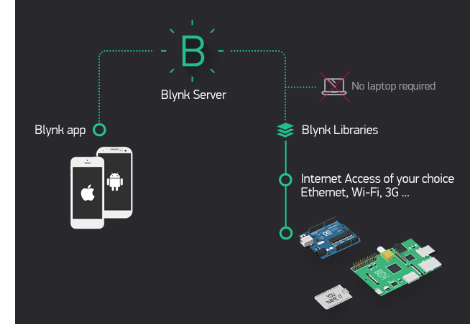
SOFTWARE COMPONENTS
1. BLYNK APPLICATION
Designed for the Internet of Things.
Control hardware remotely.
Store data and visualize it.
Three major components in the platform.
Blynk App
Allows to create interfaces for projects using various widgets.
Blynk Server
Communication between the smartphone and hardware.
Open-source.
Free service.
Fig. 6 Features of Blynk app

Slide 11
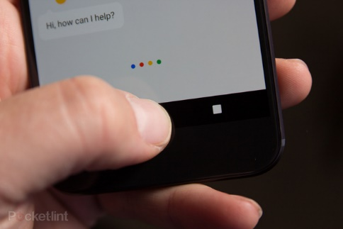
SOFTWARE COMPONENTS
Blynk Libraries
Enable communication with the server.
Message travels through Blynk app > Blynk Cloud > hardware.
Blynk of an eye.
Send commands directly to NodeMCU.
2. GOOGLE ASSISTANT
Google’s voice-controlled smart assistant.
Supports both text or voice entry.
Recognize voice profile for different people.
Find information online.
Fig. 7 Google assistant

Slide 12

SOFTWARE COMPONENTS
3. IFTTT
Simple & easy to use.
Free service.
IFTTT- IF THIS THEN THAT
THIS represent a primary app - where action take place.
THAT represent a secondary app - automatically take response to action.
4. ARDUINO IDE
Contains a text editor for writing code, a message area etc.
Upload programs to microcontrollers .
Fig. 8 Ifttt

Slide 13
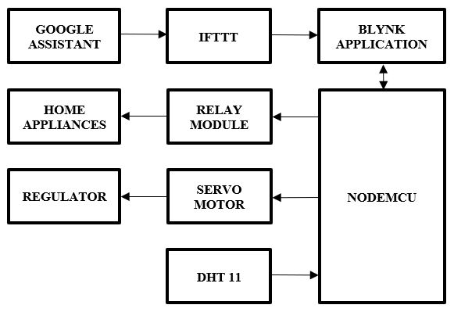
BLOCK DIAGRAM
Fig. 9 Block diagram representation

Slide 14
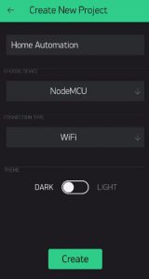
BLYNK APP SETUP
Blynk app can directly connect to the NodeMCU and send data to it.
Available in play store.
Login to it using Email.
Create a new project.
Give the project name.
Hardware device is NodeMCU.
Connection type as WIFI, and hit create.
Blynk will send an Auth token to our email id.
Fig. 10 Creating project

Slide 15
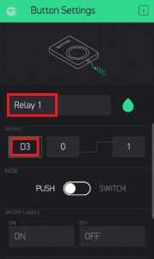
BLYNK APP SETUP
Click on the Button name as ‘Relay 1’ .
Select the pin as digital pin D3.
Repeat the process 3 more times and add three more buttons.
Naming them Relay 2, Relay 3 and Relay 4.
Choosing their Digital Pins as D4, D5 and D6 respectively.
Fig. 11 Creating buttons

Slide 16
BLYNK APP SETUP
Virtual pins to connect DHT11 and Servo Sg90.
V5 and V6 for DHT 11.
V1 and V2 for Servo Sg90.
Fig. 12 Final Blynk setup

Slide 17
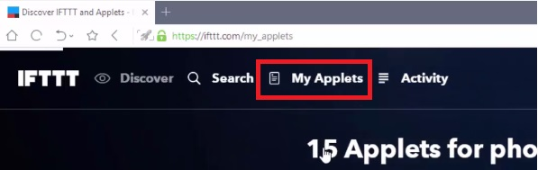
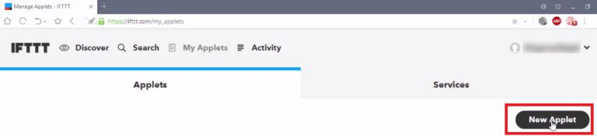
IFTTT SETUP
Sign up to IFTTT’s website.
Click on My Applets and select New Applet.
Fig. 13 Creating applets in IFTTT

Slide 18
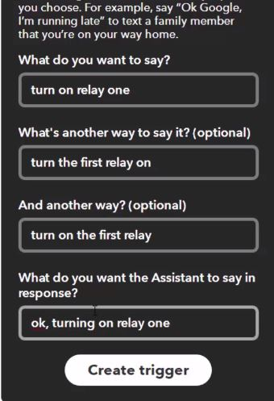


IFTTT SETUP
Click on ‘this’.
Search for Google Assistant.
Select the card “Say a simple phrase”.
In the first textbox type the phrase that we want to say.
Write some other 2 ways.
Then ‘Create Trigger’.
Click on ‘that’. Select webhooks and connect.
Fig. 14 Creating trigger in IFTTT

Slide 19
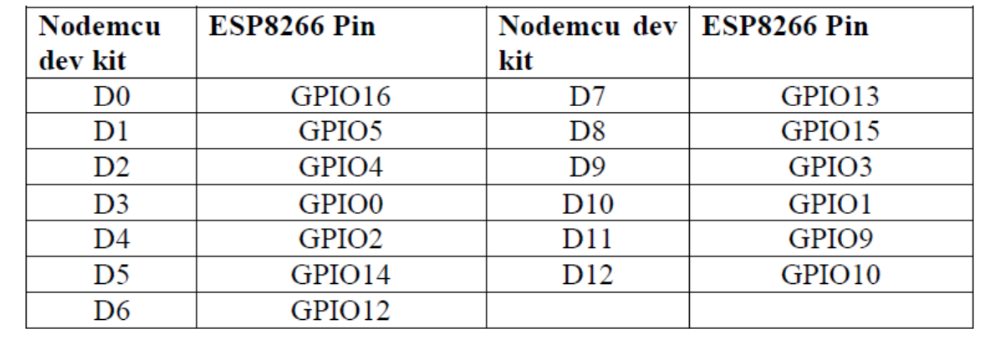
IFTTT SETUP
URL: http://188.166.206.43/YourAuthTokenHere / update /DigitalPinToBeUpdateHere
Replace the “YourAuthTokenHere” part with Blynk Auth token.
Table. 1 Mapping of NodeMCU

Slide 20
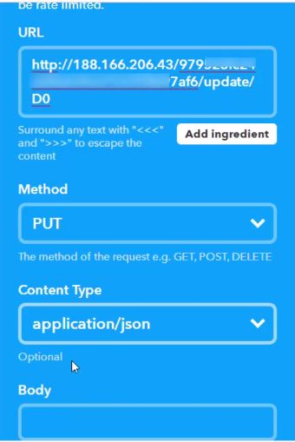
IFTTT SETUP
End the URL should look like this: http://188.166.206.43/ d5846384ef7140cfg54699bbc97f2ad8 / update / D0
Select the ‘Method’ field as PUT
Select ‘Content type’ as Application/JSON.
For the ‘Body’ type this: [“0”]
Here ‘0’ means to turn on.
Now ‘Create Action’.
In the end for 4 relays, we should have 8 triggers.
Fig. 15 Creating trigger in IFTTT

Slide 21
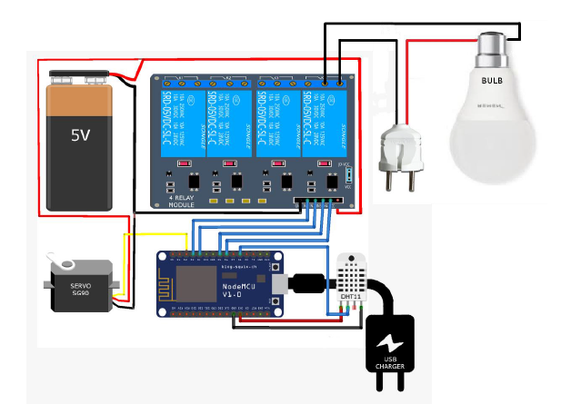
CIRCUIT DIAGRAM
Fig. 16 Circuit diagram

Slide 22
WORKING
NodeMCU act as network server.
Blynk act as a interface.
Controlling device is Google Assistant.
Voice commands like “Turn on,turn off’’.
Action is sent to the Blynk through IFTTT.
State of switches(relays) in the blynk changes.
Switching command is passed to NodeMCU through blynk server.
NodeMCU will give commands to the relay board.
Relay board acts as switch.
By using Servo motor and slider we can Control appliances.

Slide 23
COST AND EXPENDITURE
COMPONENT | QUANTITY | PRICE(Rs)
Male to Female Jumper wire (40 pcs) | 1 | 85
Relay Module 4CH 5 volt | 1 | 249
ESP8266 NodeMCU | 2 | 700
WeMos D1 Mini | 1 | 415
Dht 11 | 1 | 99
Servo SG-90 | 1 | 180
Total cost |  | 1728
Table. 2 Cost and expenditure

Slide 24
CONCLUSION
A novel and simple Home Automation System.
Energy conservation can be done.
Complete control over the home appliances from a long distance.

Slide 25
RESULTS
Fig. 17 Controlling appliences using Google assistant

Slide 26
REFERENCE
Codemetry: https://codeometry.in/home-automation-using-nodemcu-and-google-assistant/
IFTTT: https://ifttt.com/
Blynk: https://www.blynk.cc/
Google Assistant: https://assistant.google.com/

Slide 27
THANK YOU

